Slide 1
SOLID Principles

Slide 2
Quick Question…
What is the difference between a class and an instantiated object?

Slide 3
Object Oriented Programming Review
Why not just put all of your code in one giant class/method?
Break things down into smaller chunks, so you can focus on one problem at a time!
Data → Properties on Classes
Procedures → Methods on Classes
Instantiate Classes to make Objects
Execute methods with and on those objects

Slide 4
Object Oriented Programming Review
OOP gives you tools to make Coding Better!
Encapsulation
Getter and Setter methods to access and change properties on an instantiated object
Abstraction
Thinking the Input and Output of a method, not every line of code
Inheritance
Not having to copy and paste code
Know how to use something without reading all of it
Polymorphism
Being able to do the same thing in different ways
Overloading(or overriding) functions that have been inherited
Using the same name for a method that takes in different parameters

Slide 5
Object Oriented Programming Review
Can you use all of these OOP ideas/tools in still write really bad code?
YES!

Slide 6
What is SOLID?
Definitions
SOLID is an acronym for 5 Dos and Don'ts(Principles) of OOP that makes writing large amounts of code much Better and easier
S - Single Responsibility Principle
O - Open/Close Principle
L - Liskov's Substitution Principle
I - Interface Segregation Principle
D - Dependency Inversion Principle
What is Better?
Readability: People who have never seen your code can quickly understand what is doing and why
Testability: Your code is laid out in a way where testing is possible and easy
Extensibility: Changing and adding onto your code is easy and doesn't break everything else in your code in the process
Reusability: Your code is DRY and usable in other contexts

Slide 7
What is SOLID
Principles Not Rules
Principles meaning Subjectivity
Violation of a Principle is often clearer, correct solution varies.
Based on context/situation, personal preference, and your team
Examples Driven

Slide 8
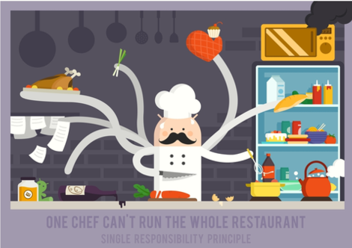
Single Responsibility Principle

Slide 9
Single Responsibility Principle
Intent
Single purpose classes
A class should have one, and only one reason(or responsibility) to change
Don'ts/Code Smells:
God Classes / Methods (a class that does everything)
Class / Method names that include ‘and’ in them
Difficulty identifying single purpose for class
Requires a large number of unit tests to test a single function or class
Dos:
Make sure anyone can easily identify the purpose of the class, its methods, and where it fits into your app.
Don’t name a class or method with the word 'and' in it, but split them into two methods or classes and make them work together.

Slide 10
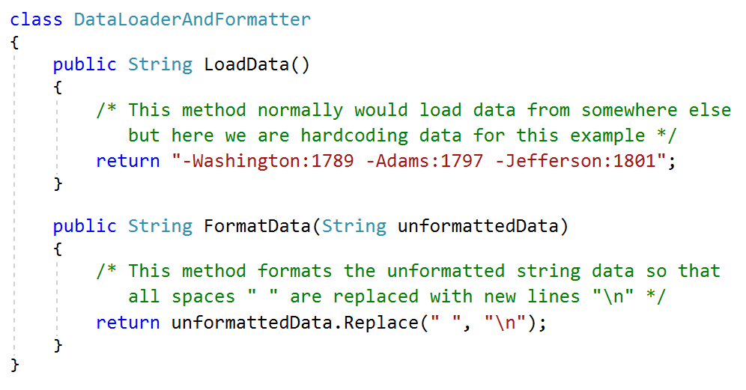
Single Responsibility Principle

Slide 11
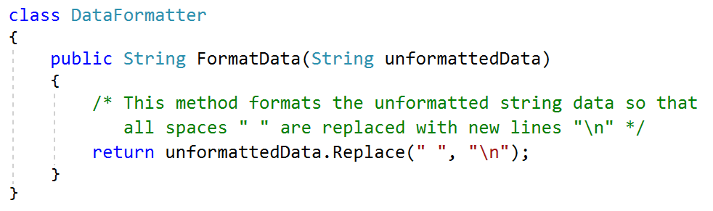
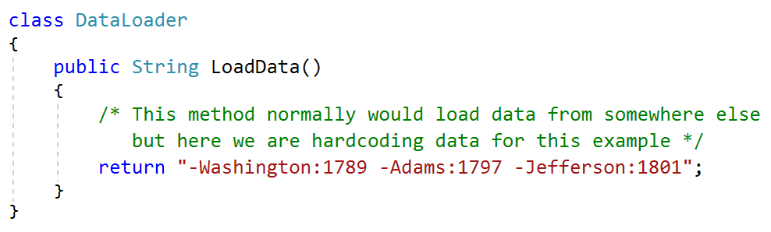
Single Responsibility Principle

Slide 12
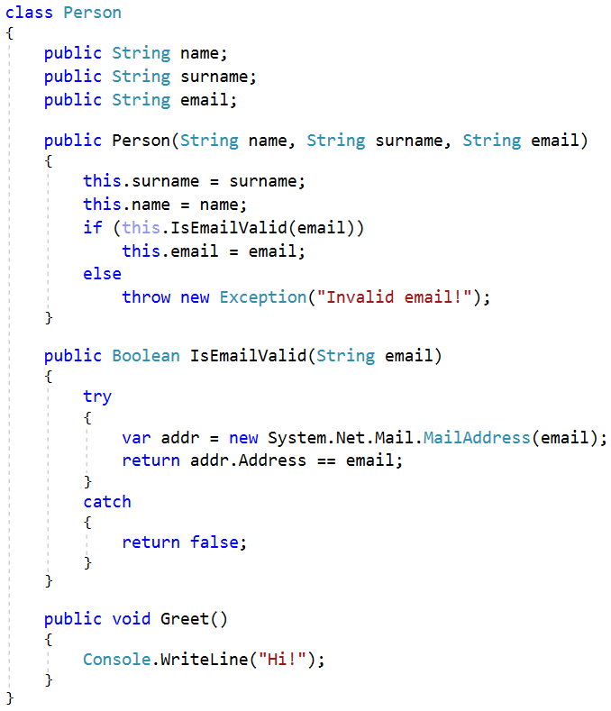
Single Responsibility Principle

Slide 13
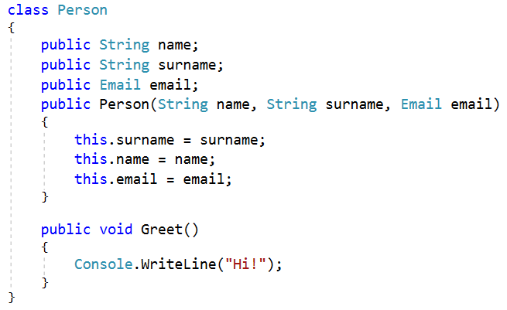
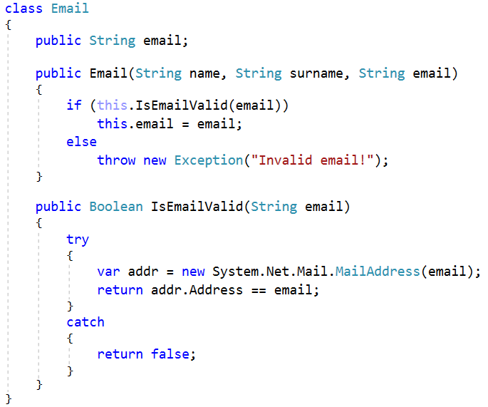
Single Responsibility Principle

Slide 14
Single Responsibility Principle
Intent
Single purpose classes
A class should have one, and only one reason(or responsibility) to change
Don'ts/Code Smells:
God Classes / Methods (a class that does everything)
Class / Method names that include ‘and’ in them
Difficulty identifying single purpose for class
Requires a large number of unit tests to test a single function or class
Dos:
Make sure anyone can easily identify the purpose of the class, its methods, and where it fits into your app.
Don’t name a class or method with the word 'and' in it, but split them into two methods or classes and make them work together.
It’s about Limiting the Impact of Change!
Resource: https://hackernoon.com/you-dont-understand-the-single-responsibility-principle-abfdd005b137

Slide 15
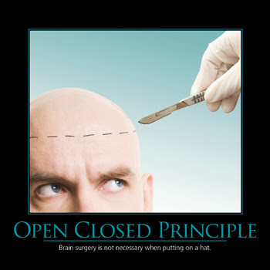
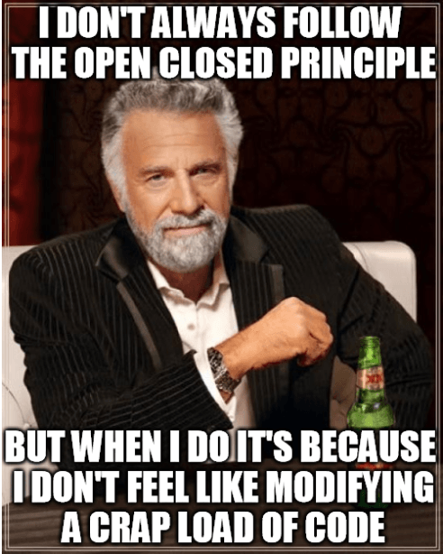
Open / Closed Principle

Slide 16
Open / Closed Principle
Intent
A class should be open for extension but closed for modification
You should be able to change how your code works without editing your code/classes
Don'ts/Code Smells:
In order to add or change functionality you have to edit your methods
Changes to cascade into other classes
Long and many if-then/switch-case chains
Dos/How?:
Abstraction and Polymorphism is Key!
Tactic 1: Single Responsibility Principle
Tactic 2: Use polymorphism to get rid of bad conditionals
You can use polymorphism to get rid of every ‘type-check’ conditional

Slide 17
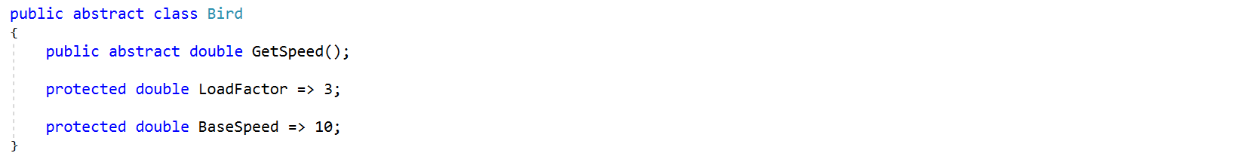
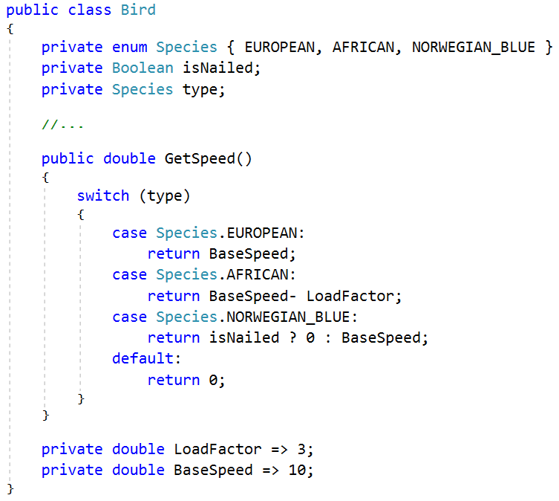
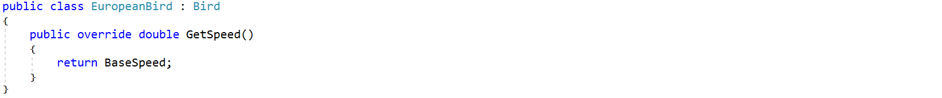
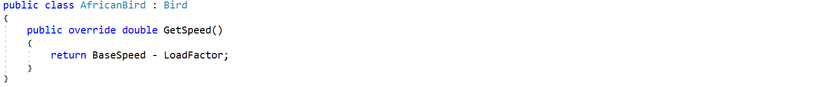
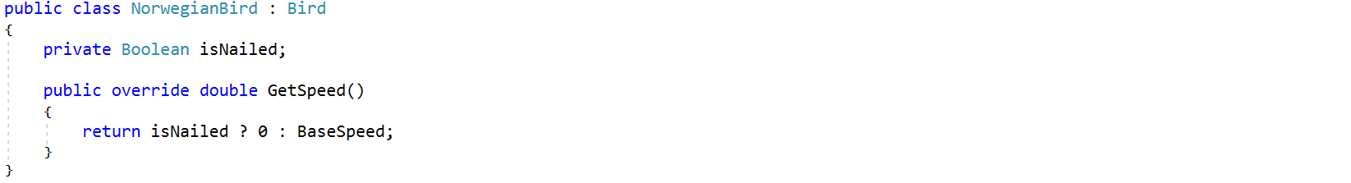
Open / Closed Principle
Implementation later

Slide 18
Open / Closed Principle
Intent
A class should be open for extension but closed for modification
You should be able to change how your code works without editing your code/classes
Don'ts/Code Smells:
In order to add or change functionality you have to edit your methods
Changes to cascade into other classes
Long and many if-then/switch-case chains
Dos/How?:
Abstraction and Polymorphism is Key!
Tactic 1: Single Responsibility Principle
Tactic 2: Use polymorphism to get rid of bad conditionals
You can use polymorphism to get rid of every ‘type-check’ conditional
Tactic 3: Inject your behaviors
Dependency injection using Behavior/Doer Classes using Interfaces

Slide 19
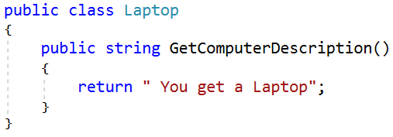
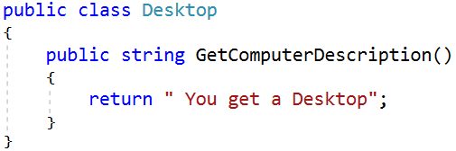
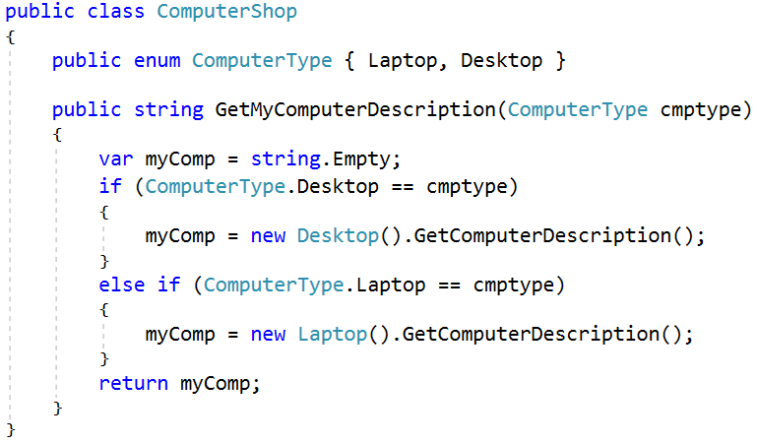
Open / Closed Principle

Slide 20
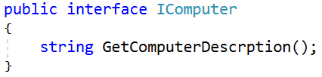
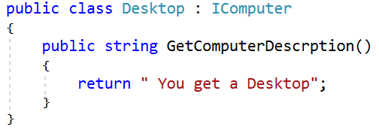
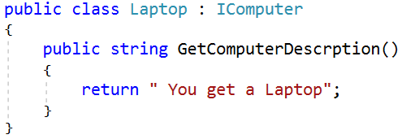
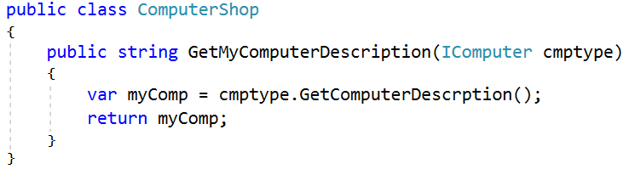
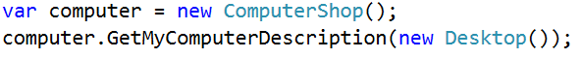
Open / Closed Principle

Slide 21
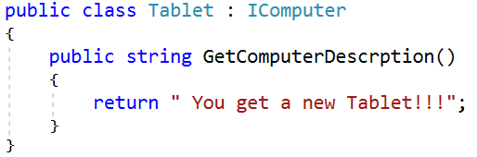
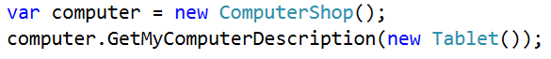
Open / Closed Principle

Slide 22
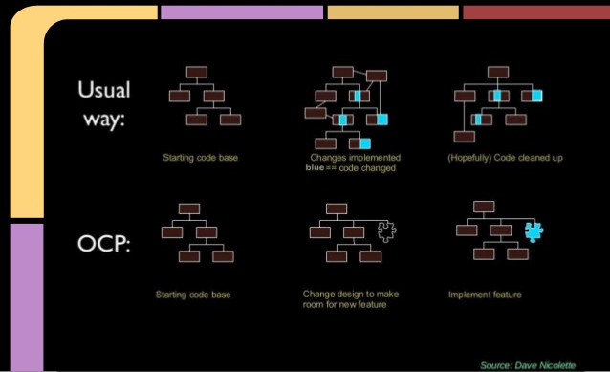
Open / Closed Principle

Slide 23
Open / Closed Principle
Intent
A class should be open for extension but closed for modification
You should be able to change how your code works without editing your code/classes
Don'ts/Code Smells:
In order to add or change functionality you have to edit your methods
Changes to cascade into other classes
Long and many if-then/switch-case chains
Dos/How?:
Abstraction and Polymorphism is Key!
Tactic 1: Single Responsibility Principle
Tactic 2: Use polymorphism to get rid of bad conditionals
You can use polymorphism to get rid of every ‘type-check’ conditional
Tactic 3: Inject your behaviors
Dependency injection using Behavior/Doer Classes using Interfaces
Compose your so that you can Write New Code, not Edit Old Code

Slide 24
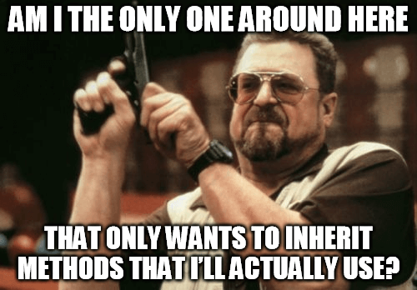
Liskov’s Substitution Principle

Slide 25
Liskov’s Substitution Principle
Intent
Derive class must be usable through their base type interface, without the need for the user to know the difference
You can't have a subclass that doesn't have a valid use/implementation of the base classes methods
Don'ts/Code Smells:
Methods exist in the base class that aren’t relevant in the derived class
Dos:
Favor Composition Over Inheritance
Use Dependency Injection to pass around functionality

Slide 26
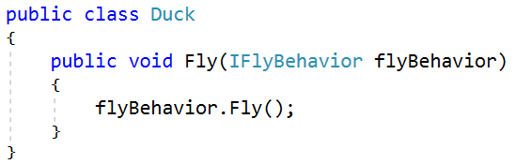
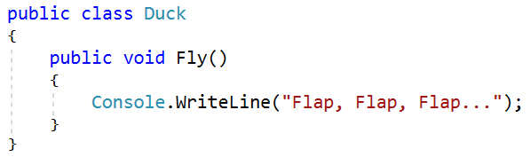
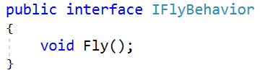
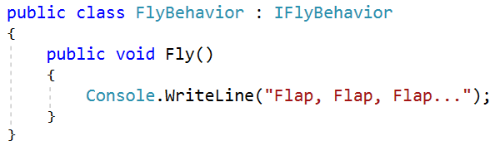
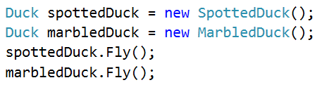
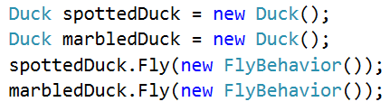
Liskov’s Substitution Principle

Slide 27
Liskov’s Substitution Principle
Intent
Derive class must be usable through their base type interface, without the need for the user to know the difference
You can't have a subclass that doesn't have a valid use/implementation of the base classes methods
Don'ts/Code Smells:
Methods exist in the base class that aren’t relevant in the derived class
Dos:
Favor Composition Over Inheritance
Use Dependency Injection to pass around functionality
Make sure when you do use inheritance, that every method on the base-class has a valid implementation in the sub-class
Make sure you can swap out a base-class usage anywhere in your code with one of it's sub-classes and everything still works(but not necessarily the other way around)

Slide 28
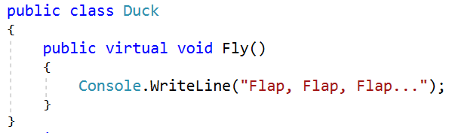
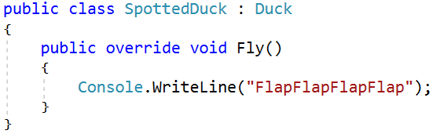
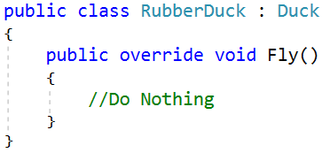
Liskov’s Substitution Principle

Slide 29
Liskov’s Substitution Principle
Intent
Derive class must be usable through their base type interface, without the need for the user to know the difference
You can't have a subclass that doesn't have a valid use/implementation of the base classes methods
Don'ts/Code Smells:
Methods exist in the base class that aren’t relevant in the derived class
Dos:
Favor Composition Over Inheritance
Use Dependency Injection to pass around functionality
Make sure when you do use inheritance, that every method on the base-class has a valid implementation in the sub-class
Make sure you can swap out a base-class usage anywhere in your code with one of it's sub-classes and everything still works(but not necessarily the other way around)
Resource: https://www.youtube.com/watch?v=ObHQHszbIcE

Slide 30
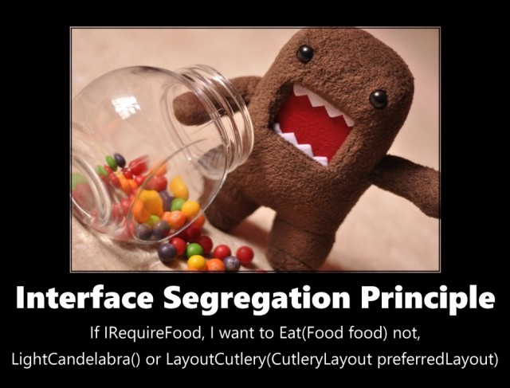
Interface Segregation Principle

Slide 31
Interface Segregation Principle
Intent
It's better to have many small interfaces rather than a few large interfaces
Don'ts/Code Smells:
Large Interfaces that could logically be split into multiple smaller interfaces
Classes that fake out methods on an interface they are using
Dos:
Make sure your interfaces logically as separate as what makes sense
Favor small over large interfaces

Slide 32
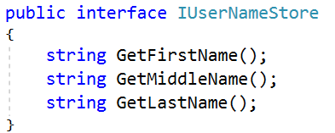
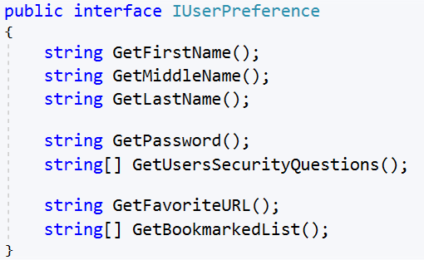
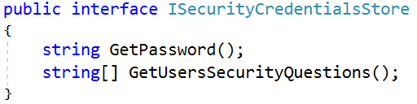
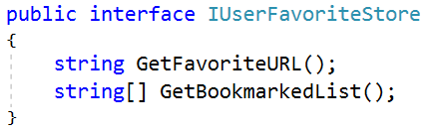
Interface Segregation Principle

Slide 33
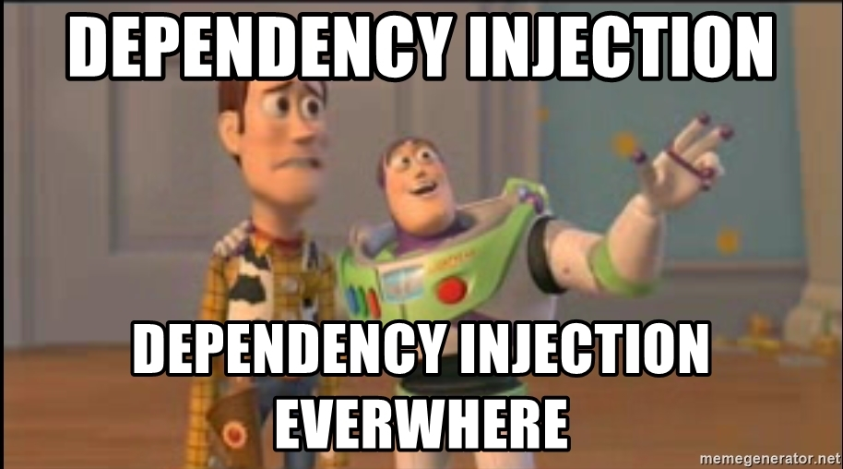
Dependency Inversion Principle

Slide 34
Dependency Inversion Principle
Intent
'High level' classes should not depend on 'low level' classes or preform 'low level' duties but should instead should invert these dependencies
Don'ts/Code Smells:
Tightly Coupled Code
Hardcoded instantiations of classes in other classes
High level classes depend heavily on specific low level classes
If you want to add or change out a 'lower level' class, you have to change things in many places
Unit tests require set up for classes other than the one I am testing
Unit tests are ‘impossible’ due to external dependencies
Dos:
Always coupling your dependencies to an abstraction
Use Method and Constructor Injection with interfaces, abstract classes, and base classes

Slide 35
Dependency Inversion Principle

Slide 36
Dependency Inversion Principle

Slide 37
How Does Do the SOLID?:
Write Code in smaller Chunks
Single Responsibility & Interface Segregation
Favor Composition over Inheritance
Liskov's Substitution, Open/Close, Dependency Inversion
Inheritance is inflexible and can creates tightly coupled code
Interfaces over inheritance
Use dependency injection with interfaces to inject behavior
Avoid many nested Inheritances but instead compose your classes in bundles where they work together(modules) then compose those modules to make your program.

Slide 38
How Does Do the SOLID?:
Inheritance
= Inheritance
= Instantiation
= Class
= Abstract Class
= Interface
Instantiate Lower level Classes

Slide 39
How Does Do the SOLID?:
Composition
= Inheritance
= Instantiation
= Class
= Dependency Injection
= Abstract Class
= Interface
= Module
Instantiate Composed Modules

Slide 40
How Does Do the SOLID?:
Write Code in smaller Chunks
Single Responsibility & Interface Segregation
Favor Composition over Inheritance
Liskov's Substitution, Open/Close, Dependency Inversion
Inheritance is inflexible and can creates tightly coupled code
Interfaces over inheritance
Use dependency injection with interfaces to inject behavior
Avoid many nested Inheritances but instead compose your classes in bundles where they work together(modules) then compose those modules to make your program.
Research and Practice SOLID Design Patterns
- Strategy -MVC - Singleton - Factory - Observable

Slide 41
Resources
Robert Martin’s Clean Code Video Course!!!!
https://www.oreilly.com/library/view/clean-code/9780134661742
SOLID Principles Playlist:
https://www.youtube.com/watch?v=AEnePs2Evg0&list=PLrhzvIcii6GMQceffIgKCRK98yTm0oolm
SOLID Design Patterns Video Course:
https://www.youtube.com/watch?v=v9ejT8FO-7I&list=PLrhzvIcii6GNjpARdnO4ueTUAVR9eMBpc
SOLID Design Patterns Reference material:
http://www.dofactory.com/net/design-patterns
https://www.tutorialspoint.com/design_pattern/index.htm

Slide 42

Demo / Questions

